Slide 2
Customer Churn Banking - Mortgage Customers

Slide 3
Why Combat Customer Churn?

Slide 4


Cost of Churn
“acquiring a new customer is anywhere from five to 25 times more expensive than retaining an existing one”
Source: https://hbr.org/2014/10/the-value-of-keeping-the-right-customers

Slide 5

Bottom Line Benefits of Reducing Churn
“a 5% increase in customer retention produces more than a 25% increase in profit”
Source: http://www2.bain.com/Images/BB_Prescription_cutting_costs.pdf

Slide 6

Analytics and Action
“the rise of big data is making it possible for firms to act more expediently and precisely on churn rates”
Source: https://hbr.org/2014/10/the-value-of-keeping-the-right-customers

Slide 7

Resource Constraints
Modern businesses have thousands or even millions of customers.
Your retention team do not have the resources to give attention to all of them.
Your loyal customers want time with your sales staff, not your retention team.

Slide 8


Solution: Build an AI That Predicts Which Customers Are At Risk of Churn
Most modern AI is powered by machine learning.
Machine learning algorithms learn by example from historical data.
Collect data about which customers were loyal and which customers switched to competitors, plus their characteristics e.g. demographics, past purchases, product usage, customer feedback, net promoter score

Slide 9

Not All Customers Are Equal…
One family business with 1,100 customers was shocked to discover that 350 of those customers were unprofitable, leading to a $2 million loss! Source: https://www.forbes.com/sites/lawrencesiff/2012/05/21/your-unprofitable-customers-are-killing-you/
Your retention team are too valuable to waste on retaining bad business

Slide 10
Solution: Build an AI That Predicts Customer Value
Collect data about profit margins for each customer, and their characteristics e.g. demographics, past purchases, product usage, customer feedback, net promoter score.
This type of model is often called lifetime customer value.

Slide 11

Some Customers Will Churn No Matter What You Do…
11% of customer churn could be avoided if the business simply reached out to the customer.
Source: https://www.slideshare.net/ekolsky/cx-for-executives
Reactions vary. 79% of high income households are likely to avoid vendors for 2+ years after a bad experience, compared to 54% of Generation X. Source: https://www.zendesk.com/resources/the-impact-of-customer-service/
There are problems that you can fix, and those you cannot.
Your retention team are too valuable to waste on customers who will leave no matter what you do.

Slide 12
Solution: Build an AI That Predicts Which Customers Will Respond Positively
Collect data about the results of the retention team’s work with each at-risk customer, and the customers’ characteristics e.g. demographics, past purchases, product usage, customer feedback, net promoter score.

Slide 13



A More Focussed Retention Team
Your retention team can focus on customers:
most at risk of churning, and
most valuable to retain, and
who respond positively to your retention team

Slide 14
Churn Prediction Case Study

Slide 15

The Business Problem
Banks invest a lot of resources to find customers and underwrite new mortgages. In return they collect interest on those mortgages. But if the customer pre-pays or refinances the mortgage, then the interest collected is not enough to cover the setup costs.

Slide 16

Data Collected
Demographics
Economic data
Banking behaviour
Competitor data
Customer feedback and correspondence
Whether the mortgage is pre-paid or refinanced (i.e. whether customer churn occurred)

Slide 17

DataRobot Predicts Customer Churn
The input is a table containing mortgages at various ages, the mortgage details, customer details, economic factors, text from customer correspondence and whether the customer pre-paid or refinanced in the subsequent 6 months.
DataRobot will automatically find the patterns, the links between the customer and mortgage details and whether they will churn.
You can use DataRobot’s accurate predictions to estimate the probability that a customer will churn, and create a short list of those most at risk.

Slide 18
Understanding the Data

Slide 19
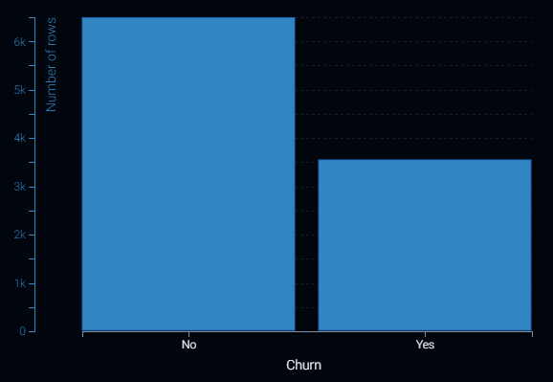
Data Summary
Target:
Note:
Use default settings in DataRobot

Slide 20
Data Dictionary

Slide 21
DataRobot Demonstration

Slide 22
What to Watch For In The Demo
Best practices and guardrails automatically applied
Automation with flexibility for experts
Full transparency. No black box models
Automatic benchmarking/challenger models
Automated Model Documentation
Flexible deployments and automatic monitoring

Slide 23
Insights and Diagnostics

Slide 24
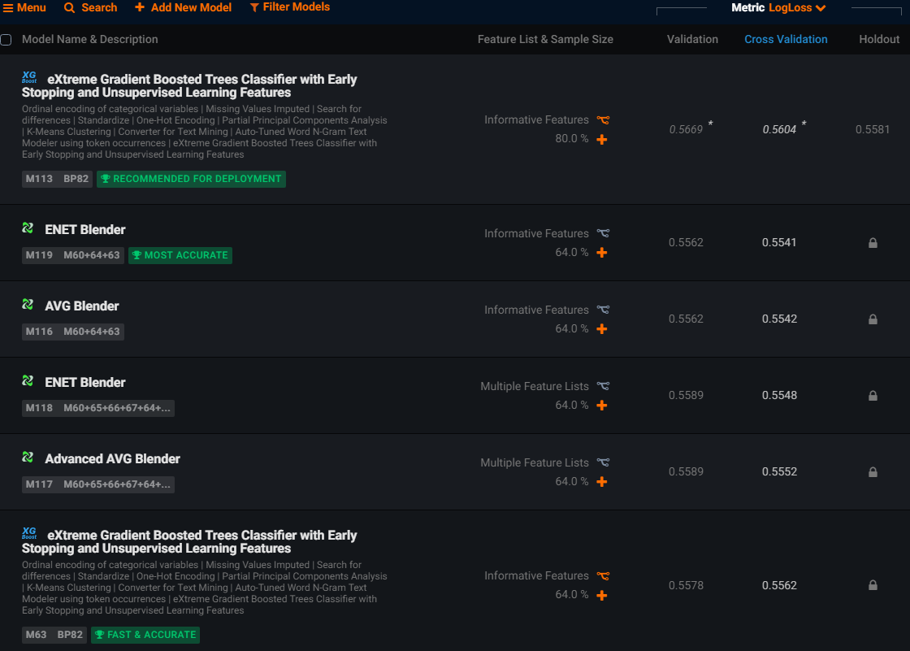
How to Find the Best Model?
69 models built for this project
5 cross-validation partitions
Some of the top blueprints for this project:
eXtreme Gradient Boosted Trees Classifier
ENET Blender
AVG Blender
Comparing a wide range of models ensures that we can find the best model to address our problem.

Slide 25
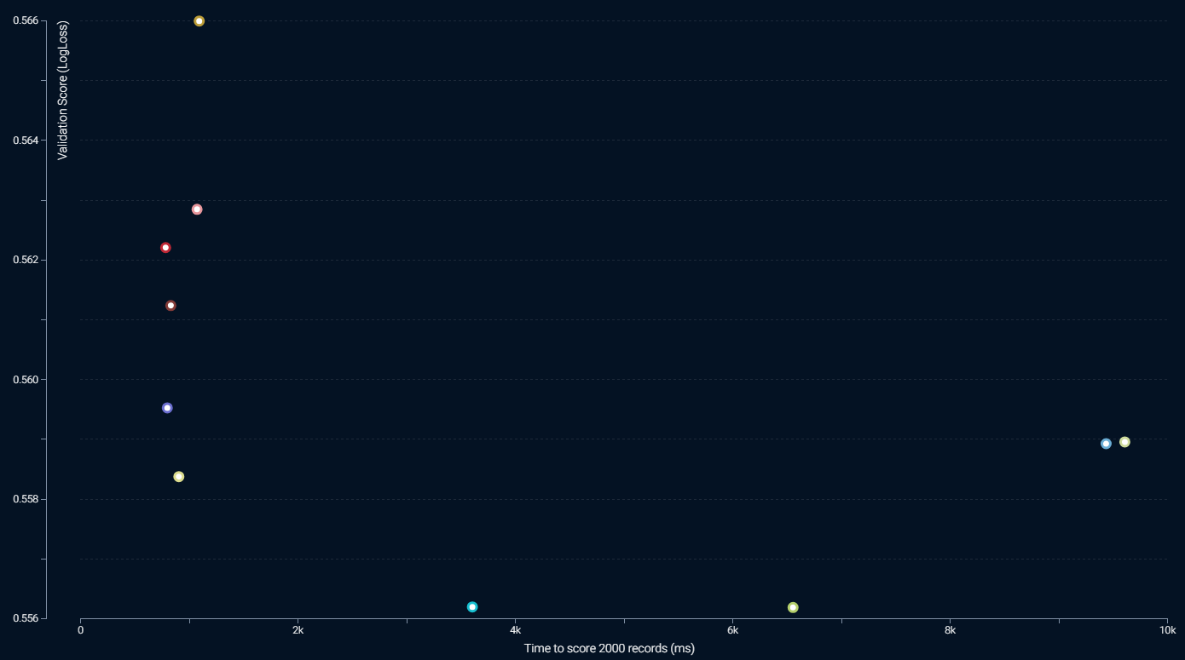
In Need of Speed or Accuracy?
Some better performing models (low validation score) take a long time to score
Business users need to determine the appropriate model for their applications, considering factors such as
Opportunity cost for wrong prediction
How fast should the data be scored
Generally, the selected model will be within this range: low validation score and low time to score

Slide 26
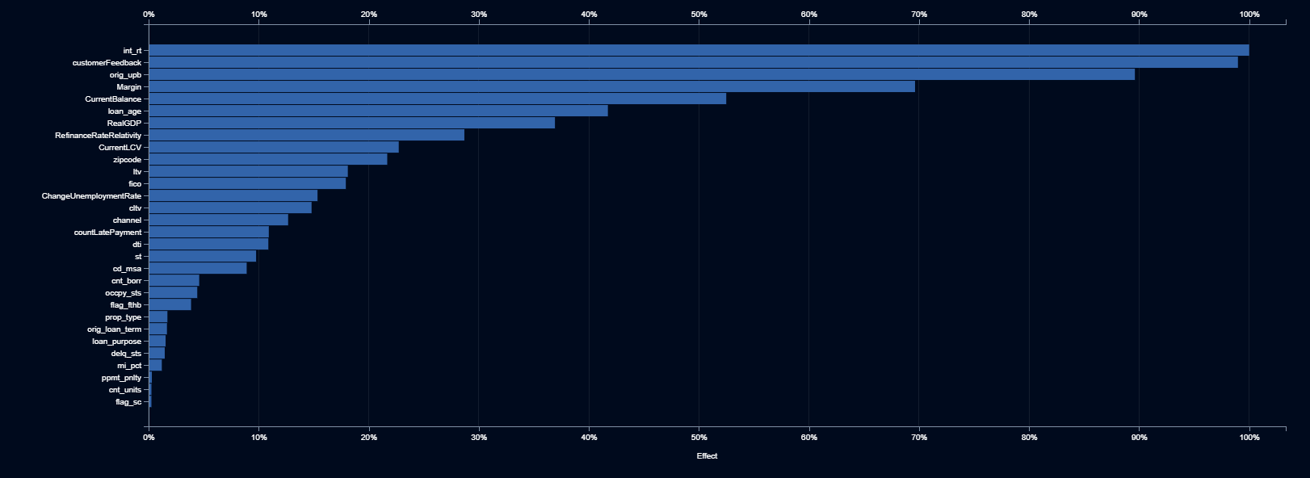
Quickly Discover What is Important
No need to wait for time-consuming variable selection
Here we see that the 6 most important features are interest rate, customer feedback text, original mortgage balance, interest rate margin, current balance and loan age.

Slide 27
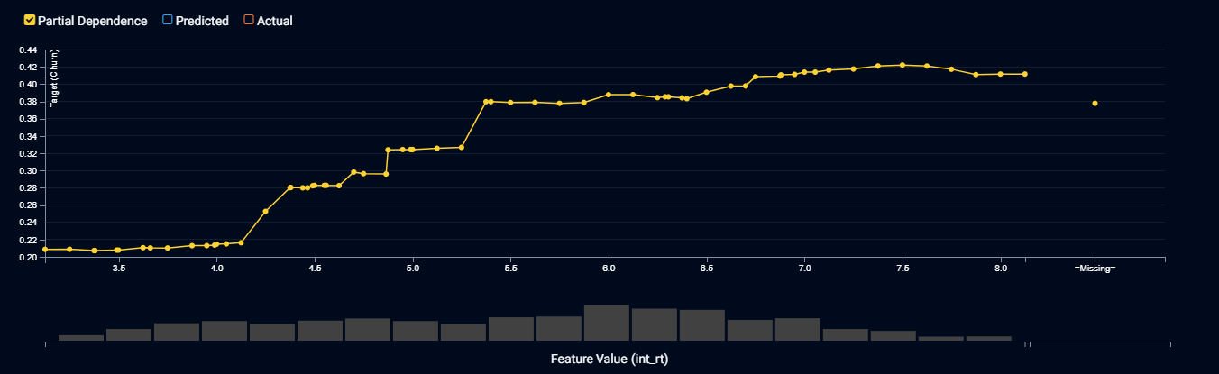
Interest Rate
The higher the interest rate on the mortgage, the more likely that a customer will churn. This makes sense, giving an estimate of price elasticity.

Slide 28
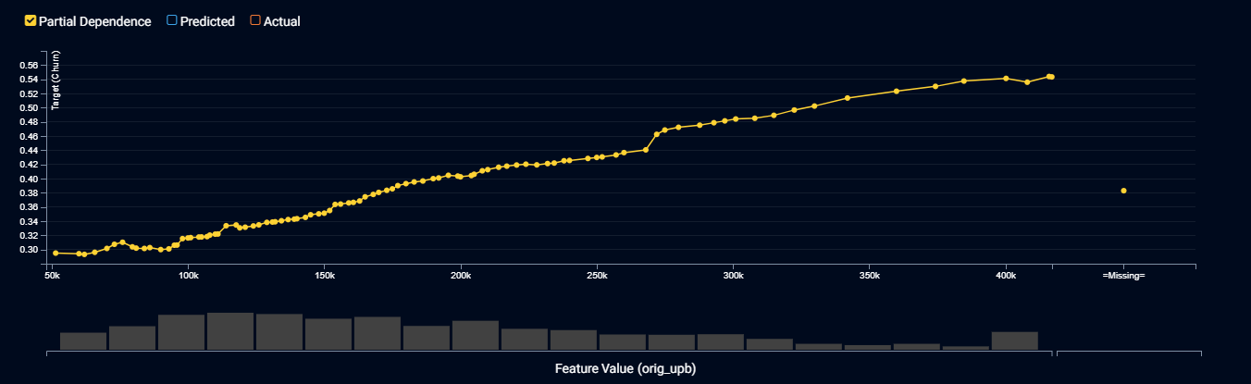
Original Balance
The higher the original mortgage balance, the more likely a customer will churn. This makes sense as those with larger mortgages have more incentive to shop around, and may possibly have greater opportunity to refinance.

Slide 29
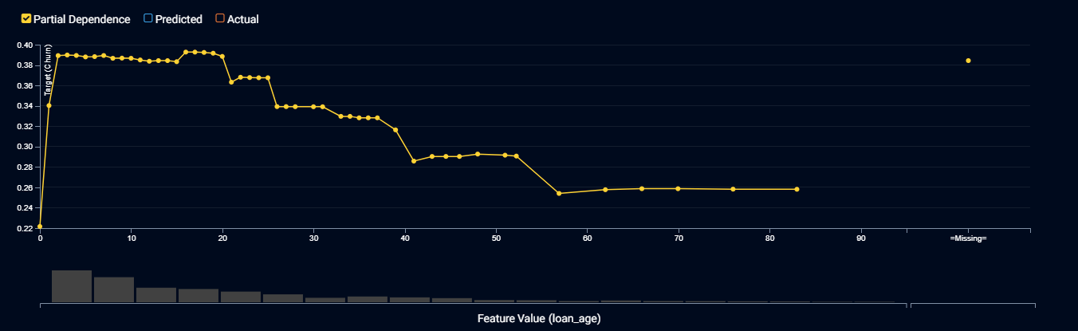
Loan Age
Customers are very unlikely to end a mortgage in the first few months after it is originated. It takes time for them to refinance, and they are unlikely to prepay when they just went through so much trouble to obtain the mortgage.
Long term mortgage customers have more inertia and are less likely to switch.

Slide 30
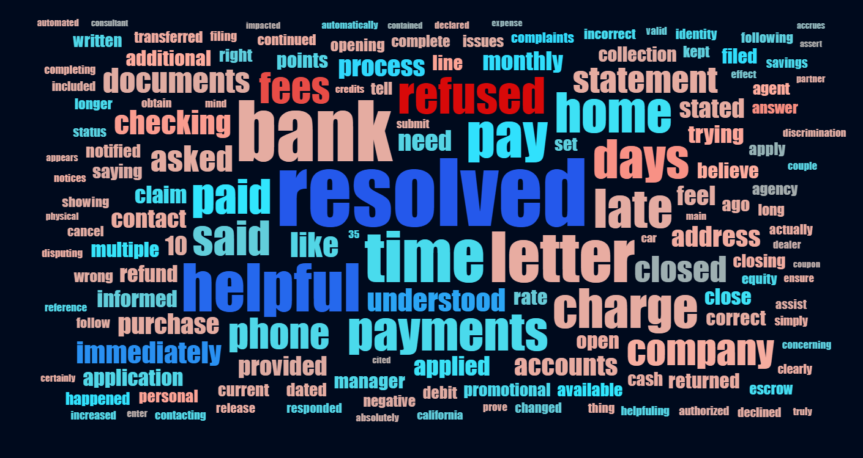
Customer Feedback
Customers who complain about fees and whose requests are refused are more likely to churn. This may indicate a poor customer experience.
Customers whose problems are resolved, who felt understood, engaging with helpful staff who fixed a problem immediately, are less likely to churn, possibly due to the positive customer experience.

Slide 31
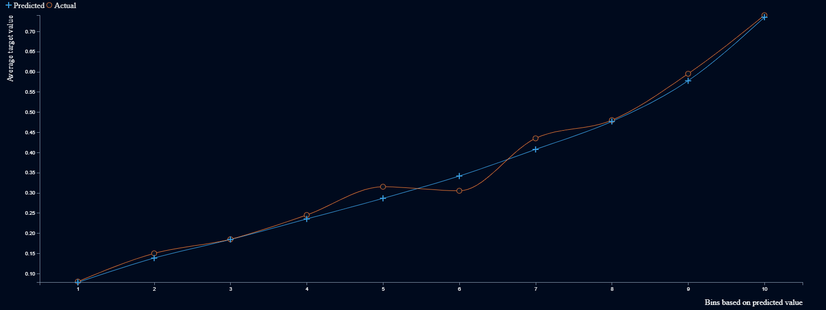
Can We Trust the Model?
The model is able to successfully rank and separate the 30% of customers who are very loyal with less than 20% probability of churn. It also successfully ranks the 25% of disloyal customers who are twice as likely to defect as an average customer.
Yes! Now that we have a trustworthy model, how do we use it?

Slide 32
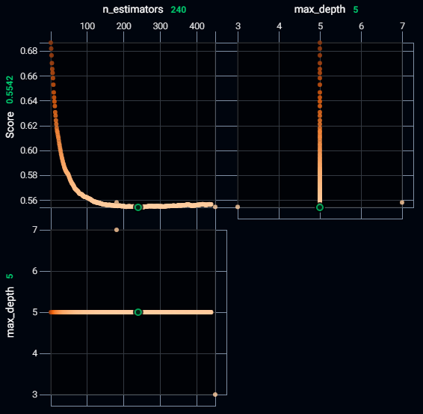
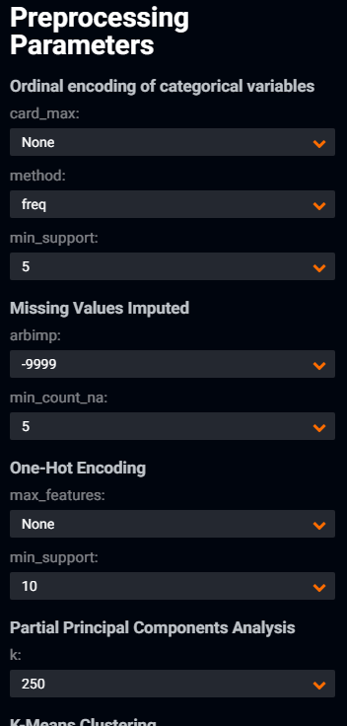
For the Data Scientist: Still Not Convinced?
Each model runs through an extensive test in determining the optimal parameters
Options are available to perform manual tuning of the model
DataRobot Tuning
Manual tuning options
Let us know if the manual tuning works better. We are constantly looking for ways to enhance our models.

Slide 33
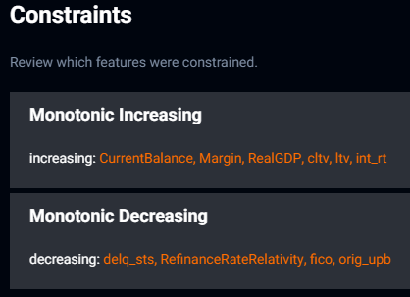
For the Data Scientist: Still Not Convinced?
Data scientists can apply monotonicity rules, to ensure that models apply patterns in a common sense manner e.g. that expected losses always increase as the current loan balance increases.

Slide 34
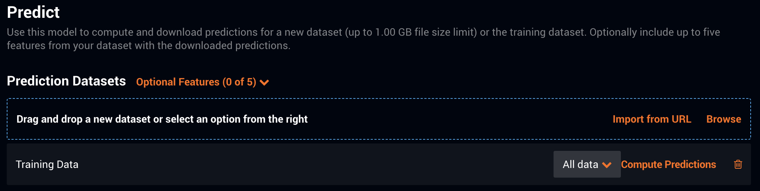
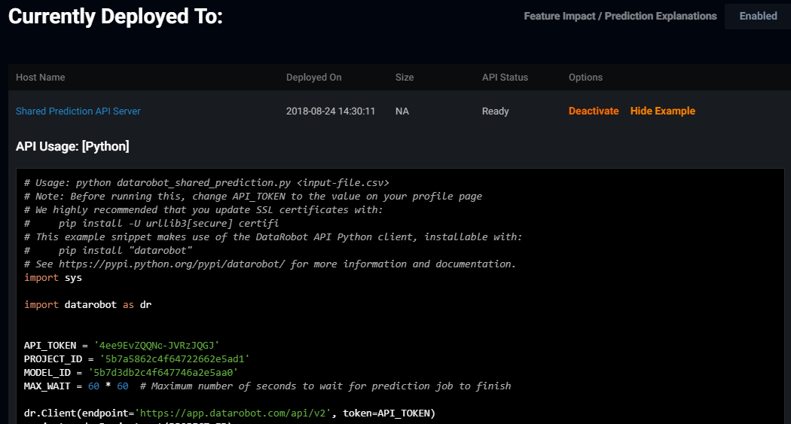
Let’s Deploy the Model!
1) GUI
Pros: Supports ad-hoc scoring
Cons: Manual process, requires network access for scoring
2) Rest API
Pros: Support automated refresh, easy to refresh the model for scoring
Cons: Requires network access for scoring

Slide 35
Questions?

